Slide 2
Change
Mark Hagquist
October 6, 2013
Traders Point church of Christ

Slide 3
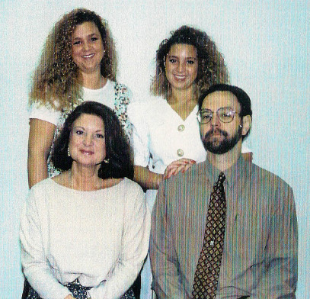
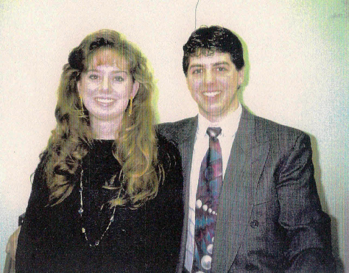
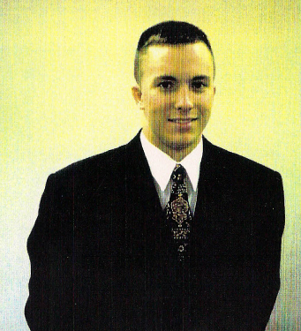

Slide 4
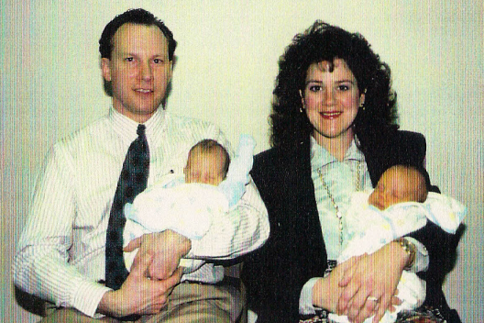
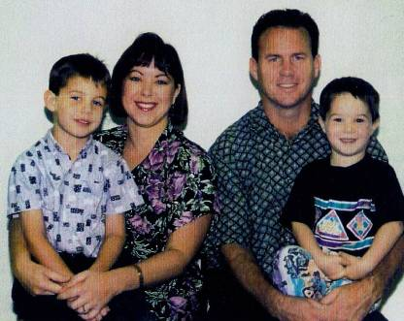

Slide 5
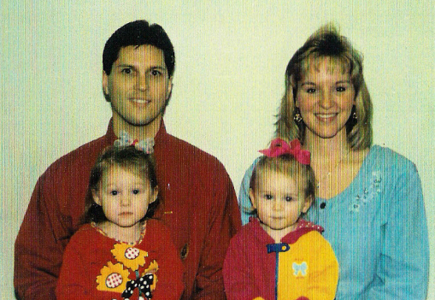
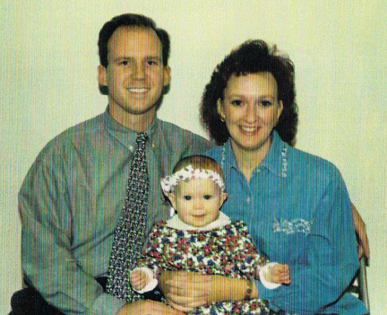
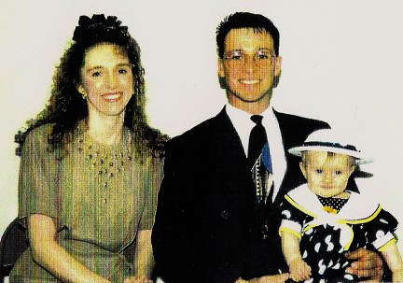

Slide 6
The World Has Changed?
Lying - Ananias and Sapphira (Acts 5:1-11)
Immoral Lives – Sodom and Gomarah (Genesis 19)
Gambling – Casting lots for Jesus’ clothes (Mark 15:24)
Murder – Cain and Abel (Genesis 4:8); David and Uriah (2 Samuel 12:9); Ahab and Jezebel and Naboth (1 Kings 21:13-14)
The world’s perception of the Lord hasn’t changed (1 Kings 20:23)

Slide 7
What Hasn’t Changed?
The power of prayer – James 5:16
The set-up of the church
Elders – 1 Timothy 3:1-7; Titus 1:4-6
Deacons – 1 Timothy 3:8-13
God and Christ – Malachi 3:6; Hebrews 13:8
We are not alone

Slide 8
What Hasn’t Changed?
Salvation!
Hear – Revelation 1:3
Believe – Acts 16:31
Repent – 2 Corinthians 7:9-10
Confess – Romans 10:9-10
Be Baptized – 1 Peter 3:21-22
Live Righteously – Philippians 4:8-9

Slide 9
Just because we have change in our lives that happens on a daily basis, never think that God has changed!

Slide 10
Do you need to change yourself?

