Slide 1
Ruth
Part 1

Slide 2
Facts about the story
Date and Author
Who is in charge
What is happening in the land
Compare to other times we have seen this situation played out in the scripture

Slide 3
Who are the players
Elimelech and Naomi
Mahlon, Chilion, Ruth, Orpah
Boaz
The extras
Judges, Moabites, Ephrathites, field workers

Slide 4
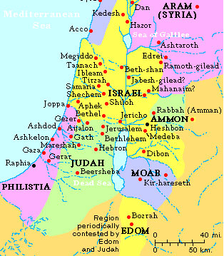
Where are they?

